Slide 1
Weekly update 4
Maxwell Mullin

Slide 2












Foreground >=9; background <= 20
Motif name | TP | FP | TN | FN | Accuracy | Sensitivity | Specificity | Logo
gimme_101_Improbizer_GTAGCTACGTTGGCTAA | 10 | 10 | 122 | 3 | 0.91 | 0.77 | 0.92
gimme_104_Improbizer_GTGCAACGGAGAGT | 12 | 7 | 125 | 1 | 0.94 | 0.92 | 0.95
gimme_106_Improbizer_AACCATCGTT | 9 | 11 | 121 | 4 | 0.90 | 0.69 | 0.92
gimme_133_MEME_4_w10 | 11 | 20 | 112 | 2 | 0.85 | 0.85 | 0.85
gimme_105_Improbizer_AACACACGTTTATTAGATGTTT | 12 | 14 | 118 | 1 | 0.90 | 0.92 | 0.89
gimme_25_BioProspector_w14_5 | 9 | 13 | 119 | 4 | 0.88 | 0.69 | 0.90
gimme_102_Improbizer_GCGTTATACCCGAGGATCAG | 12 | 7 | 125 | 1 | 0.94 | 0.92 | 0.95
DECOD_Motif5_15 | 9 | 16 | 116 | 4 | 0.86 | 0.69 | 0.88
DECOD_Motif5_16 | 11 | 18 | 114 | 2 | 0.86 | 0.85 | 0.86
DME_AVKSAGAGW | 10 | 19 | 113 | 3 | 0.85 | 0.77 | 0.86
DME_GRGAGAGV | 9 | 16 | 116 | 4 | 0.86 | 0.69 | 0.88
DME_AWMTBAGAGA | 9 | 17 | 115 | 4 | 0.86 | 0.69 | 0.87

Slide 3
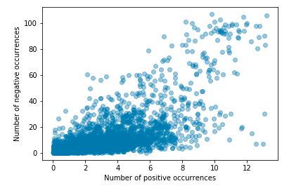
motif foreground vs background counts now with jitter and alpha

Slide 4
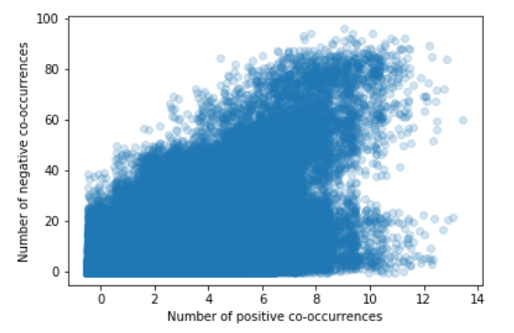
Co-occurance of motifs in the foreground and the background

